Slide 1
Methods of measurement
The methods of measurements may be broadly classified in to two categories
a)Direct measurement
b)Indirect measurement
a)Direct measurement
In this method the measured or the unknown quantity is directly compared against a standard.
This method of measurement some times produces human error and hence gives inaccurate results.

Slide 2
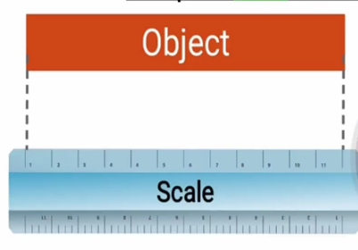
Example:
b)Indirect measurement
In this method the comparison is done with a standard through the use of calibrated system.
Calibration :when the out put intervals are matched to the size of the input signal being measured.
This method of measurement is more accurate than direct measurement.

Slide 3
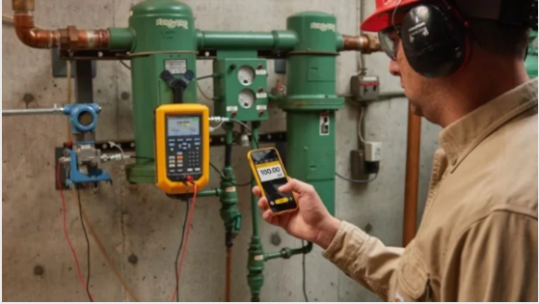

Slide 4
Characteristics of Instrumentation
What that mean instrumentation?
Instrumentation: the process or technology of using instruments to measure and control the physical and chemical properties of any material called instrumentation.
Characteristics of Instrumentation
a)Static Characteristics
b)Dynamic Characteristics

Slide 5
a)Static Characteristics
The static characteristics are defined for the instruments which measure quantities which do not vary with time.
The main static characteristics are
Accuracy
Precision
Resolution
sensitivity

Slide 6
Reproducibility
Threshold
Linearity
Stability
Range (span)
error
Tolerance

Slide 7
Accuracy: it’s the degree of closeness with which an instrument reading approaches the true value of the quantity being measured.(measuring near to the true value)
The accuracy of measurement indicate the nearness of the actual (true value) of the quantity.
Accuracy=True value – measured value
True value: the exact value of variable
measured value: value of variable's as indicated by measurement system.

Slide 8
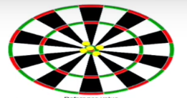
Precision: is defined as the capability of an instrument to show the same reading (repeatability)when we use at each time.(closeness of set of data points to one another)
Precision(p)= measured value – measured value
NB: An instrument which is precise may not be necessarily accurate.
yellow dot: is the measured value
read dot :center point (accurate value)
high accuracy and high precision

Slide 9
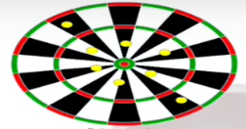
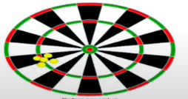
accuracy and not precision
Because the measured value is far from the true value and also jump from the circle
not accuracy and high precision
Because the measured value is compacted in one area(repeatability).

Slide 10
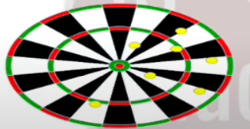
not accuracy and not precision
Resolution: the smallest change in input signal detected by any instrument .

Slide 11
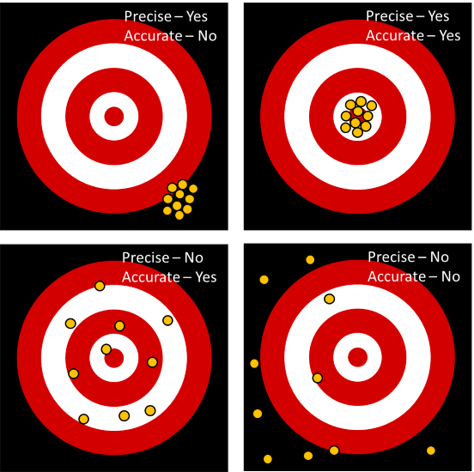

Slide 12
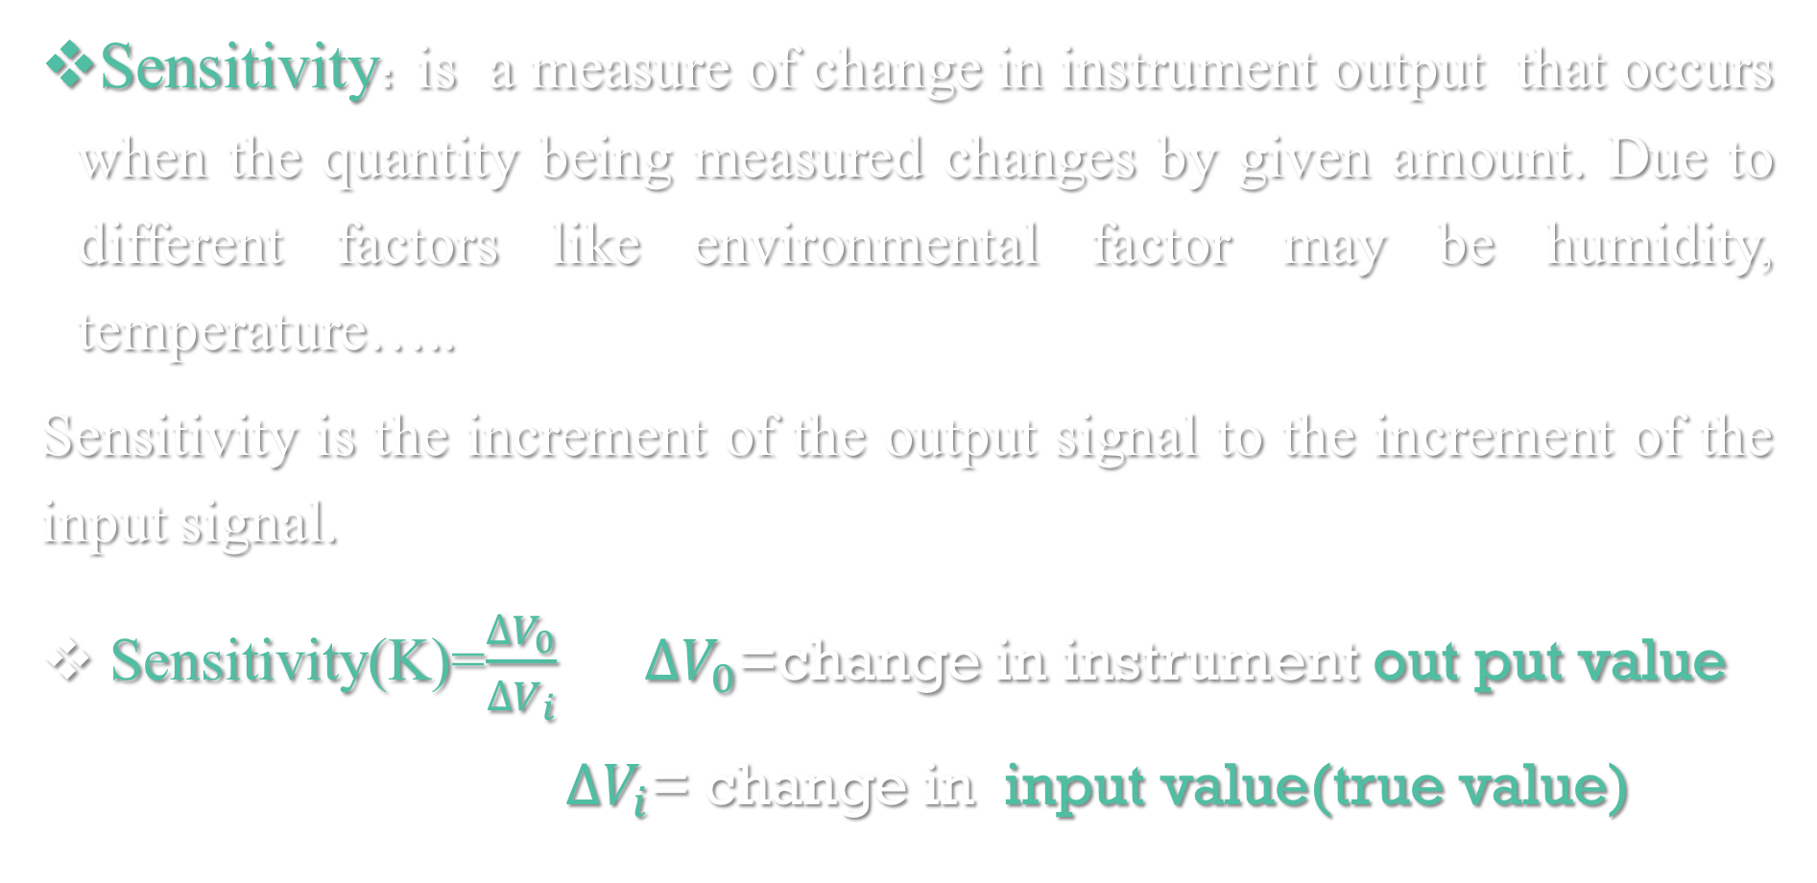
Sensitivity: is a measure of change in instrument output that occurs when the quantity being measured changes by given amount. Due to different factors like environmental factor may be humidity, temperature…..
Sensitivity is the increment of the output signal to the increment of the input signal.
Sensitivity(K)=$\frac{∆V_{0}}{∆V_{i}}$ $∆V_{0}$=change in instrument out put value
$∆V_{i}$= change in input value(true value)

Slide 13
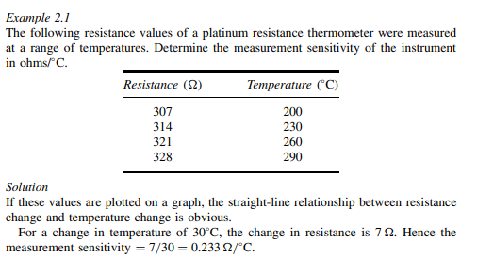

Slide 14
Reproducibility: Reproducibility is defined as the degree of closeness by which a given value can be repeatedly measured.
Perfect reproducibility signifies that the given readings that are taken for an input do not vary with time(same input).

Slide 15
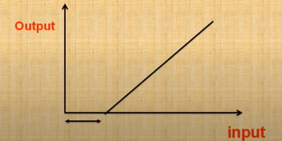
Threshold: If the instrument input is increased very gradually from zero there will be some minimum value below which no output change can be detected. This minimum value defines the threshold of the instrument.
linearity : is define as a maximum deviation of output from idealized straight line.
Linearity is simply a measure of maximum deviation of the calibrations points from the ideal straight line.

Slide 16
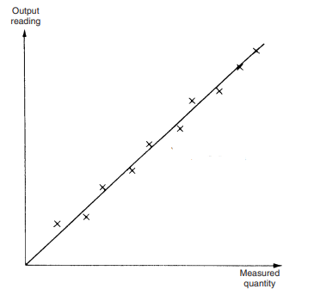
Generally Linearity measure of maximum deviation from the reading of measure value and straight line(actual value).

Slide 17
Stability : the ability of instrument to retain it’s performance through out it’s specified storge life and operating life.(The operation life time with perfect performance )
Range (span): the minimum and the maximum values of quantity for which an instrument is designed to be measure.
Error: is defined as the difference between the measured value and the true value(as per standard).
NB: No measurement can be made with perfect accuracy and precision.

Slide 18
Error = measured value- true value
Sources of error
Construction error
Approximation error
Operating error
Ageing errors
Environmental effects

Slide 19
Types of error
Systematic errors
Random errors
Gross errors
Systematic errors: the error which do not vary from one reading to another due to approximation.
Random errors(accidental errors):These errors are caused due to random variations in the parameter or the system of measurement. Such errors vary in magnitude and may be either positive or negative on the basis of chance .

Slide 20
Gross errors: these type of error manly comprises of human mistakes in reading instruments due to incorrect adjustment and recording and calculating measurement results(computational mistakes).
The experimenter is mainly responsible for these errors. These errors can be avoided by taking great care in reading and recording the data.
Tolerance: The maximum allowable error in the measurement is specified in terms of some value which is called tolerance.

Slide 21
b)Dynamic Characteristics
The dynamic characteristics are defined for the instruments which measure quantities which vary with time.
Speed of response: it’s defined as the rapidity with which an instrument responds to a change in the value of the quantity being measured.(how quakily responded to input signal)

Slide 22
Fidelity: degree of closeness with which the system indicates or records the signal which is applied upon it.
It refers to the ability of the system to reproduce the output in the same form as the input.
Poor fidelity indicates non linearity of instrument.

Slide 23
Overshoot: because of mass and inertia of moving part
That the pointer of instrument does not immediately come to rest in the final deflected position.
the pointer goes beyond the steady state that is over shoot.
Response time(Ts): time taken by the instrument to reach its stable value from zero. Once the excitation is applied.

Slide 24


